Slide 1
Current, Voltage, Resistance, and Power
Samantha Salazar

Slide 2
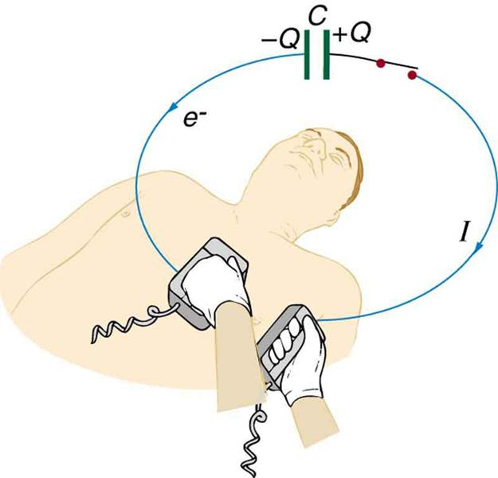
Problem
(a) A defibrillator sends a 6.00-A current through the chest of a patient by applying a 10,000-V potential as in the figure below. What is the resistance of the path? (b) The defibrillator paddles make contact with the patient through a conducting gel that greatly reduces the path resistance. Discuss the difficulties that would ensue if a larger voltage were used to produce the same current through the patient, but with the path having perhaps 50 times the resistance.

Slide 3
Ohm’s law
Ohm’s law:
States that current (I) is proportional to the potential difference where R is the resistance or I=V/R
ohmic:
material where Ohm’s law is valid

Slide 4
Part A

Slide 5
Equation
R= V/I
Resistance
=
Voltage
Current
Ohms (Ω)
Volts (V)
Amps (A)

Slide 6
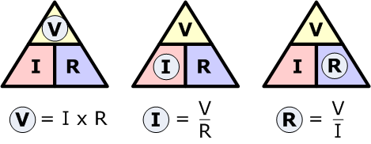

Slide 7
r= 10000 V/ 6.00 A
= (1667 Ω) (10^⁻³ kΩ/1 Ω)
= 1.67 kΩ
Resistance of path is 1.67 Ω

Slide 8
Part B

Slide 9
Equation used
𝑃 =𝐼²𝑅
2
Electric Power
Current
x
Resistance
=
Watts (W)
Amps (A)
Ohms (Ω)

Slide 10
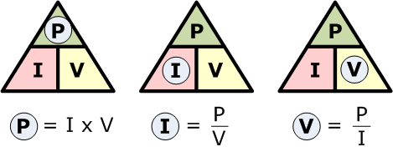

Slide 11
Final power
P ^{f}= I² (50 R)
= (50)(I²R)
= 50 P
Power transfers 50 times greater and can travel through the human body. Because the molecules are moving so fast it generates so much heat that it may cause burns

Slide 12
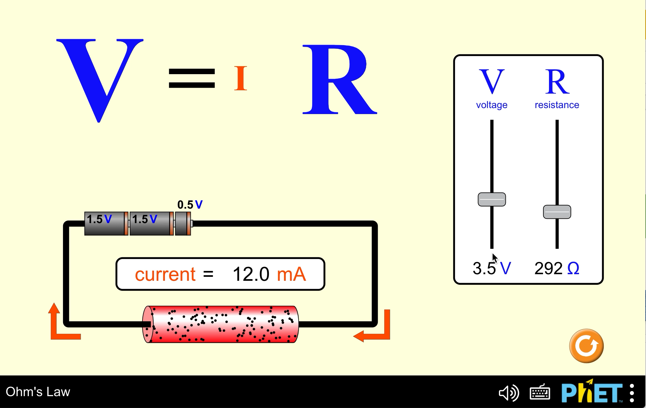

Slide 13
Applications
We can know how the path of resistance changes with or without a resistance
How current flows through the human body
Know how the different variables influence each other

Slide 14

Thank you for watching!

Slide 15
Citations
Ohms Law Tutorial and Power in Electrical Circuits. Basic Electronics Tutorials. Published August 11, 2013. Accessed April 2, 2021. https://www.electronics-tutorials.ws/dccircuits/dcp_2.html
OpenStax Tutor. Openstax.org. Published 2021. Accessed March 27, 2021. https://tutor.openstax.org/book/11087/page/67521
PhET Interactive Simulations. Ohm’s Law. PhET. Published August 16, 2013. Accessed March 27, 2021. https://phet.colorado.edu/en/simulation/ohms-law
‌
‌

